Slide 1
Current Situation in New Hampshire
9,958 people have already been tested for COVID-19
155 tests are underway at our Public Health Laboratories
819 people are confirmed to have COVID-19 (+31 from yesterday)
127 of these have required care in a hospital (+9 from yesterday)
21 people have died (+3 from yesterday)
COVID-19 is widespread and present in most areas in NH

Slide 2
COVID-19 The Future of the Epidemic in NH
Benjamin P. Chan, MD, MPH
State Epidemiologist
April 9, 2020

Slide 3
Important Highlights
Mathematical models help predict the COVID-19 epidemic so we can direct resources and ultimately save lives
Early data that our NH Strategy appears to be controlling the spread of COVID-19
We need to continue to work together to protect each other and those most vulnerable in NH

Slide 4
What is Community Mitigation?
Community mitigation is a package of actions that don’t involve medicines or vaccines and are important for stopping the spread of COVID-19:
Staying home
Keeping a safe distance of at least 6 feet from others
Moving to remote learning for schools
Encouraging tele-work for businesses
Cancelling mass gatherings
Closing non-essential businesses

Slide 5
Goals of Community Mitigation
Slow how fast the epidemic is spreading
Spread out when people get sick (delay the peak)
Reduce the overall number of patients
Decrease deaths
Prevent overwhelming our healthcare system

Slide 6
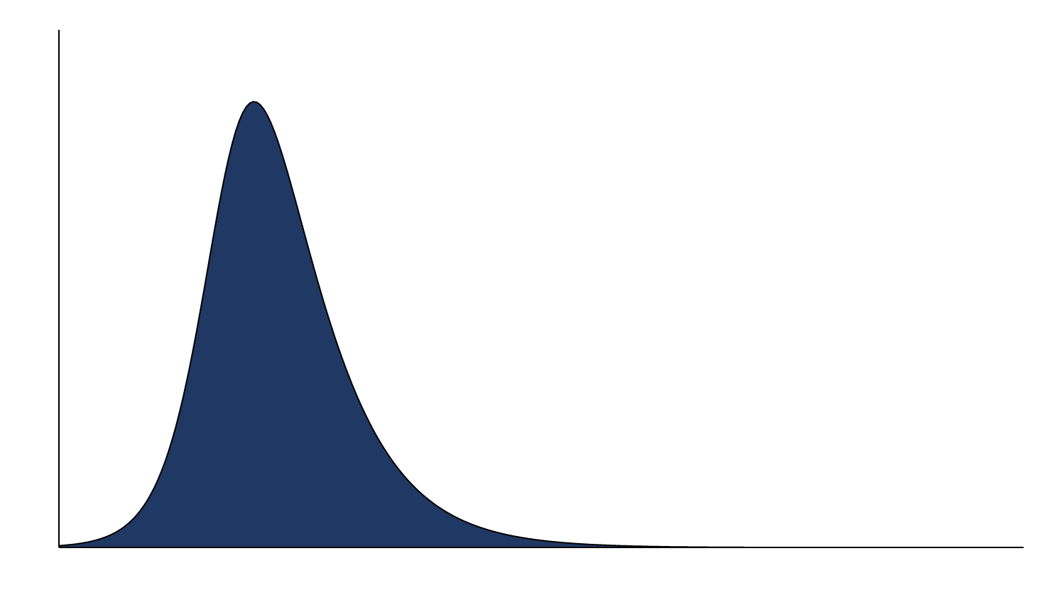
Goals of Community Mitigation
Pandemic with no interventions
Daily Cases
Days Since First Case

Slide 7
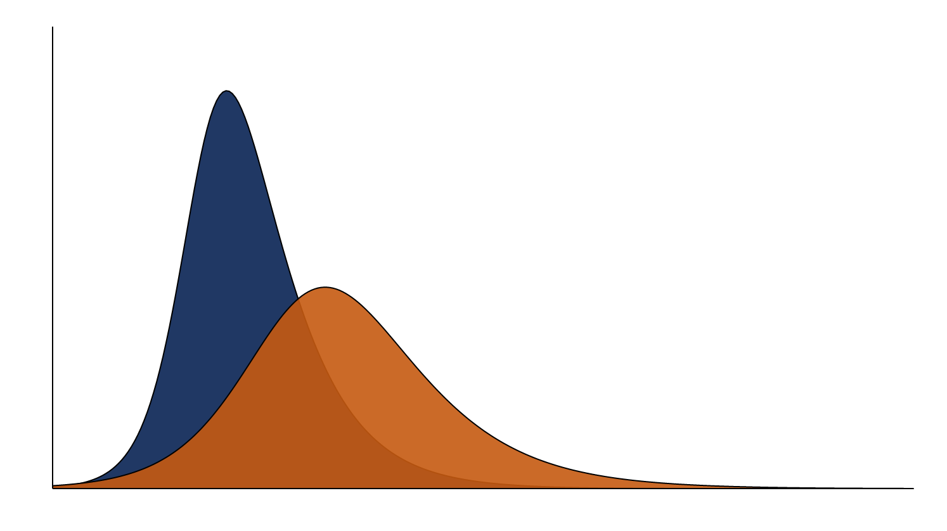
Goals of Community Mitigation
Daily Cases
Days Since First Case

Slide 8
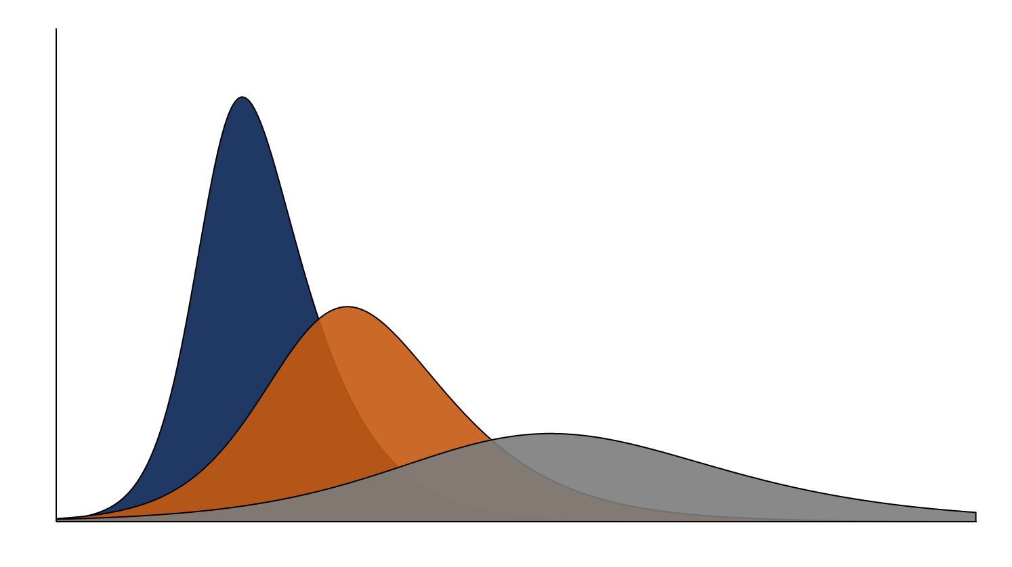
Goals of Community Mitigation
Multiple combined interventions are necessary to have the greatest effect at slowing the spread of COVID-19
Daily Cases
Days Since First Case

Slide 9
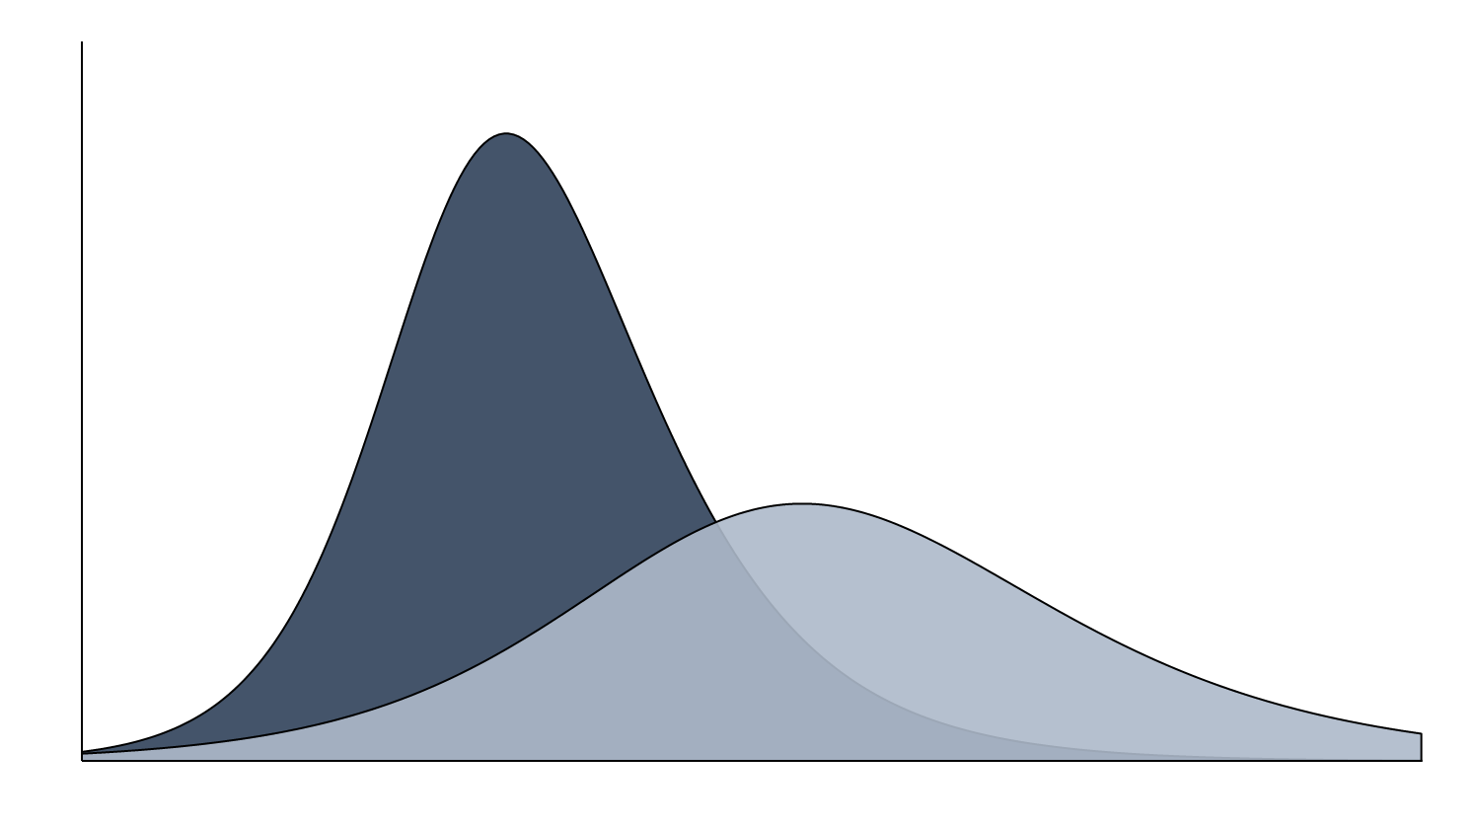
We Can Decrease the Number of Deaths
Peak (No Interventions)
40,000 Infections
800 Deaths
Daily Cases
Peak (Community Mitigation)
20,000 Infections
400 Deaths
Days Since First Case
Notes:
These diagrams are meant to be examples of the magnitude of the impact of community mitigation, not represent what we think will actually occur.
Modeling studies (Imperial College of London) have shown that with community mitigation measures we can decrease deaths by half.
We can also decrease hospitalizations by two-thirds.

Slide 10
We Can Decreased Hospitalizations
Peak (No Interventions)
8,000 Hospitalizations
Daily Cases
Peak (Community Mitigation)
2,600 Hospitalizations
Hospital Bed Capacity
Days Since First Case
Notes:
Total staffed beds in NH: ~3,000
With added surge capacity we have ~4,400 beds in NH
That’s not counting the additional surge centers we have set up with the help of the National Guard
Total ICU beds in NH: 345
With added surge capacity we have ~820 ICU beds in NH

Slide 11
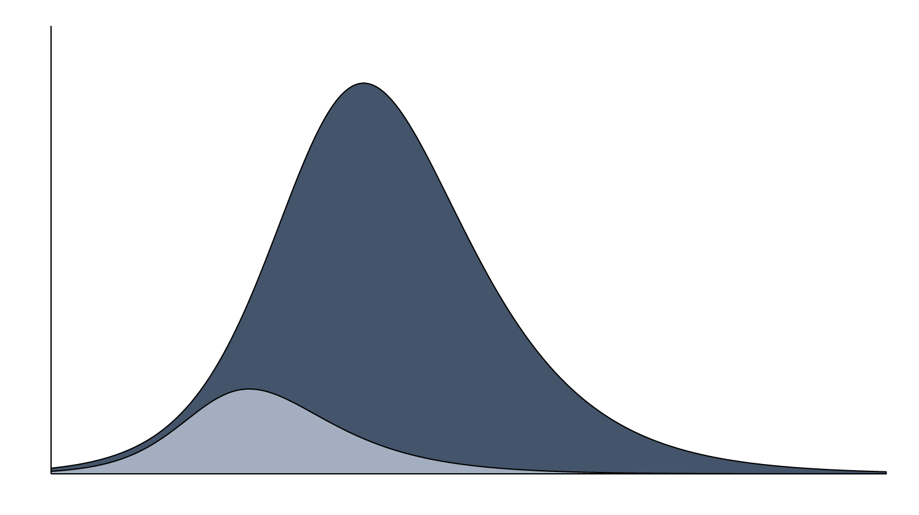
Outbreak Suppression
If our social distancing efforts are strong enough, we could stop the outbreak
Daily Cases
Days Since First Case

Slide 12
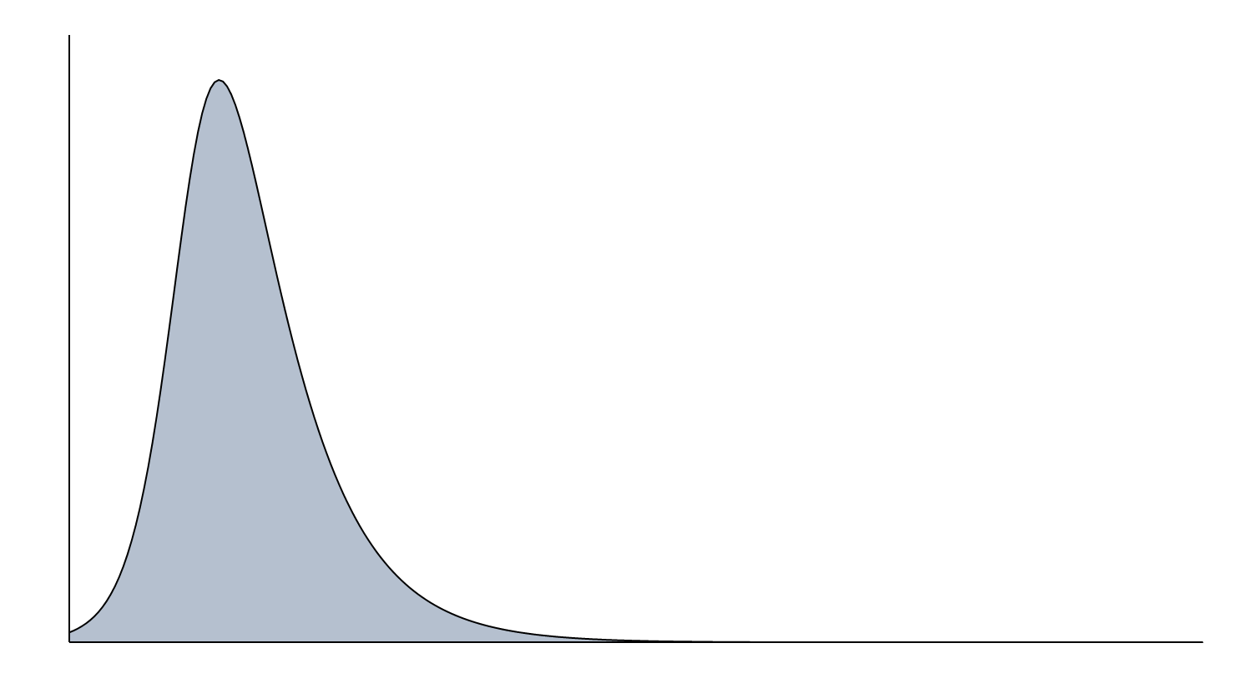
Relaxing Social Distancing
Daily Cases
Days Since First Case
Notes:
A caution against relaxing social distancing now…
Because of the early and extensive measures taken to dramatically reduce social contact (social distancing), there is likely a significant proportion of our population that has not been exposed and does not have protective antibodies. If we relax our social distancing too quickly, we risk subsequent clusters/outbreaks of infection which we will need to respond to.

Slide 13
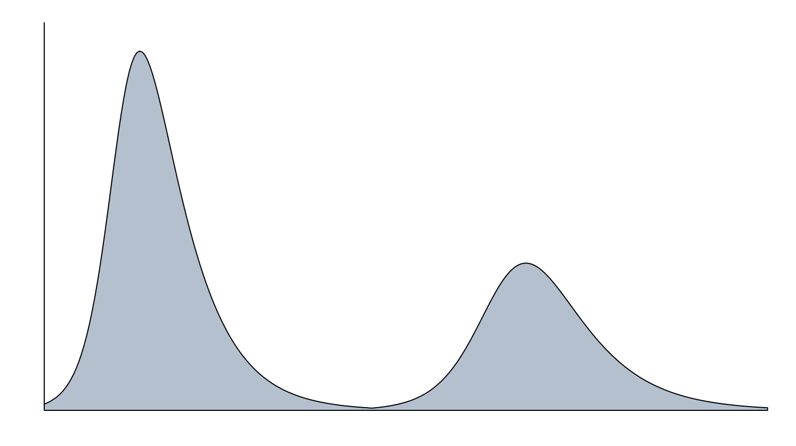
Relaxing Social Distancing
If we relax our social distancing too quickly, we risk subsequent outbreaks of COVID-19
Daily Cases
Days Since First Case

Slide 14
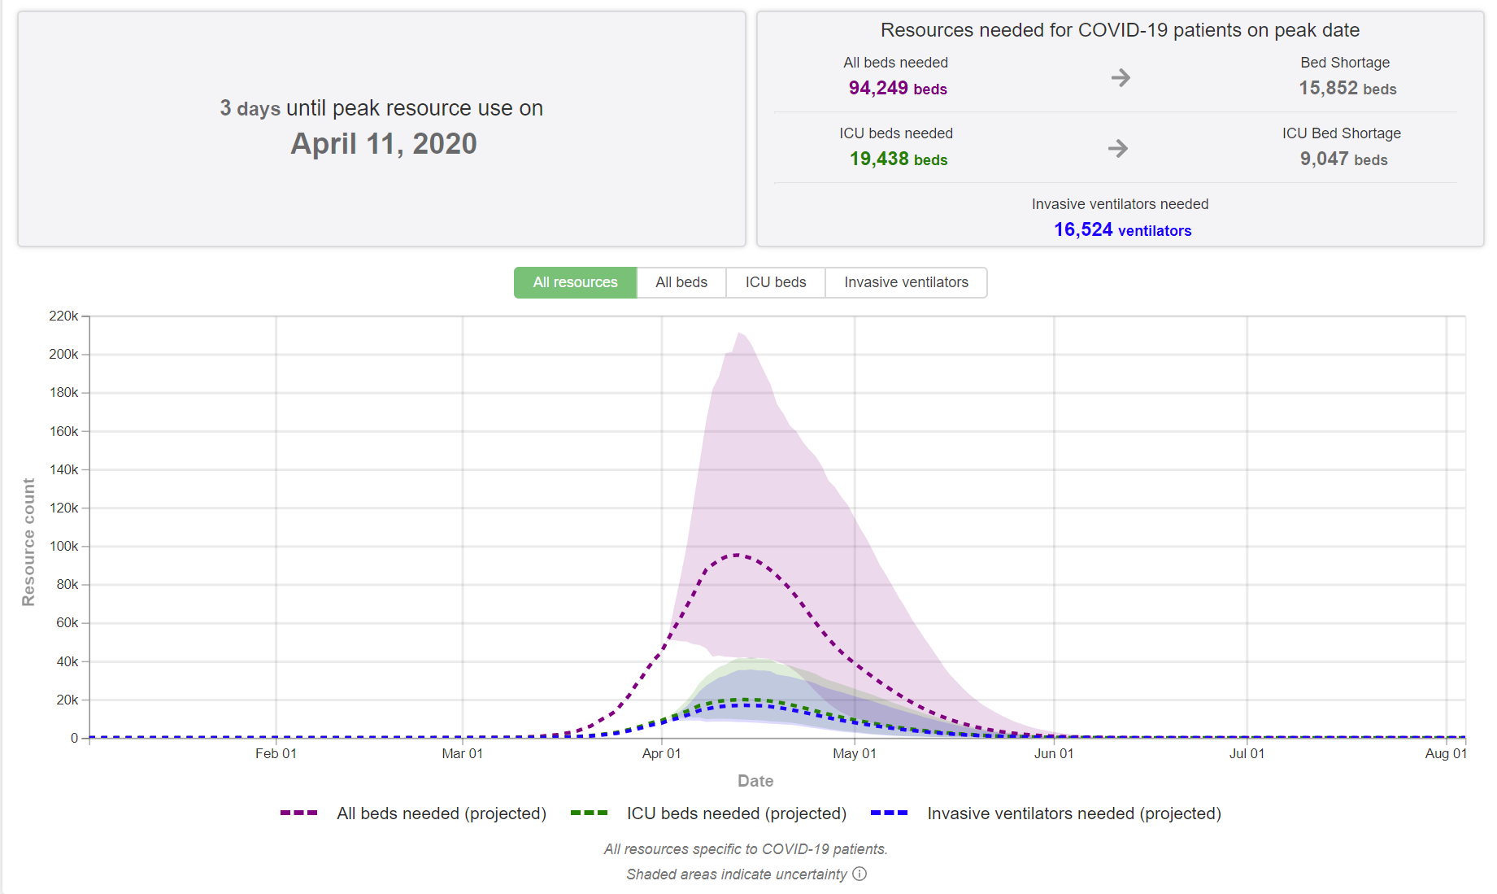
U.S. Hospital Resource Use
IHME. COVID-19 Projections. Website: https://covid19.healthdata.org/united-states-of-america.
Notes:
Institute for Health Metrics and Evaluation (IHME) @ University of Washington
Models are constantly changing based on new data. Even just a couple days ago, this model was predicting >36,000 overall bed shortage at peak and >16,000 ICU bed shortage, and more than 24,000 ventilators needed.
I’ve looked at many different models and there isn’t a single model that I think accurately predicts the future… but based on the models I have reviewed and our NH data, I believe there is a high likelihood of a potential peak within the next several weeks.
Looking at where we are now in NH in the course of the epidemic, I’m hopeful we can be successful at minimizing the health impact on our NH communities with your ongoing collective help.

Slide 15
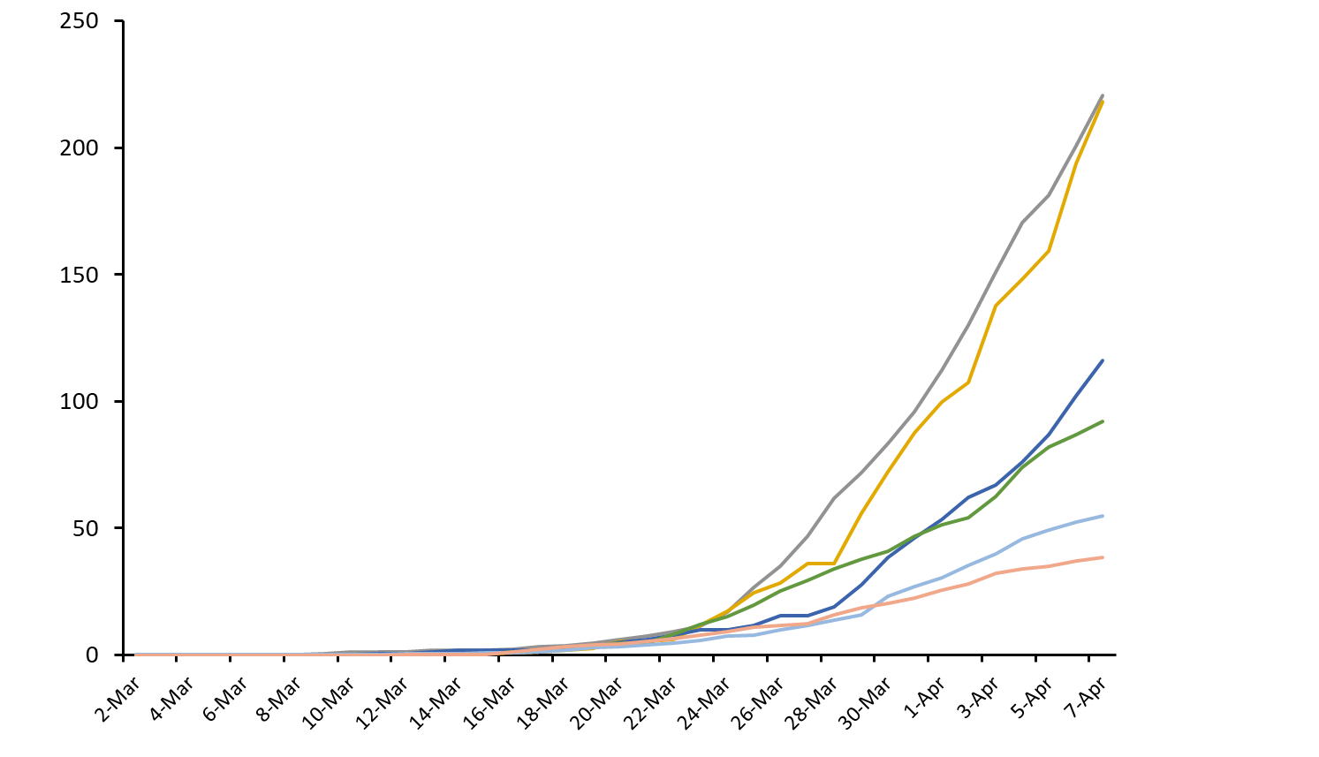
Rates of COVID-19 by State
Massachusetts
Connecticut
Cases per 100,000 People
Rhode Island
Vermont
New Hampshire
Maine
Date

Slide 16
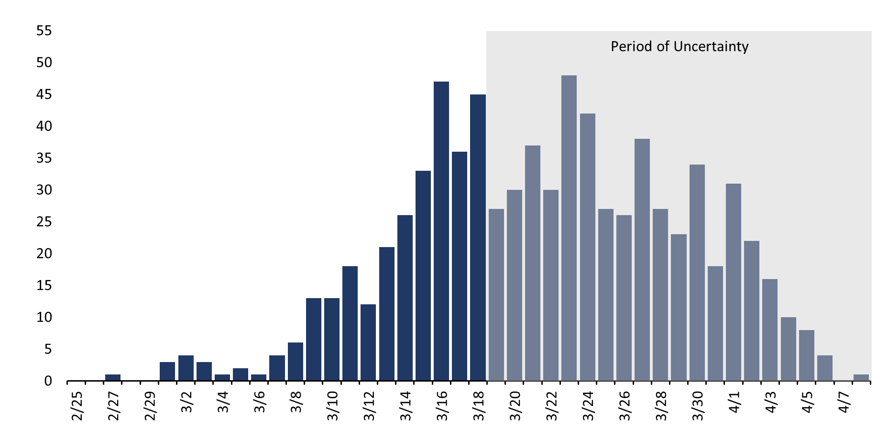
Epidemic Curve for Confirmed COVID-19 Cases in New Hampshire
Number of Cases
Date of Illness Onset
Notes:
3/13: State of Emergency
3/16: School remote learning transition
3/16: Limiting mass gatherings and closure of sit-down restaurants
3/23: limiting mass gatherings to 10 or less
3/26: closure of non-essential businesses, “stay at home” executive order

Slide 17
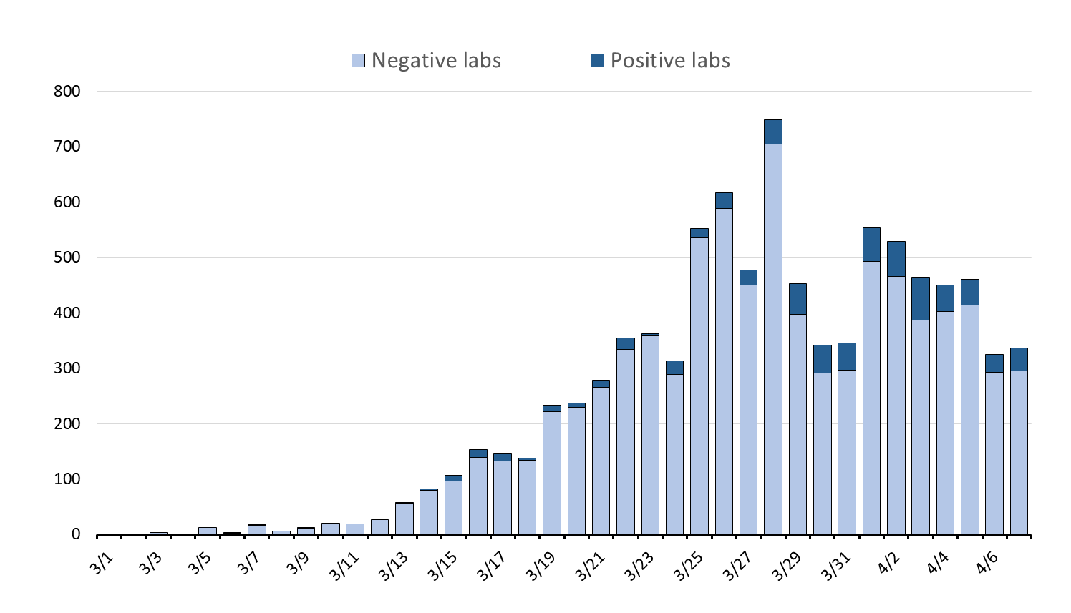
Number of People Tested Each Day in NH
Number of People Tested
Date of Reported Result
Notes:
Yesterday, more than 400 people were tested for COVID-19
So the last week have averaged around 400 tests per day.

Slide 18
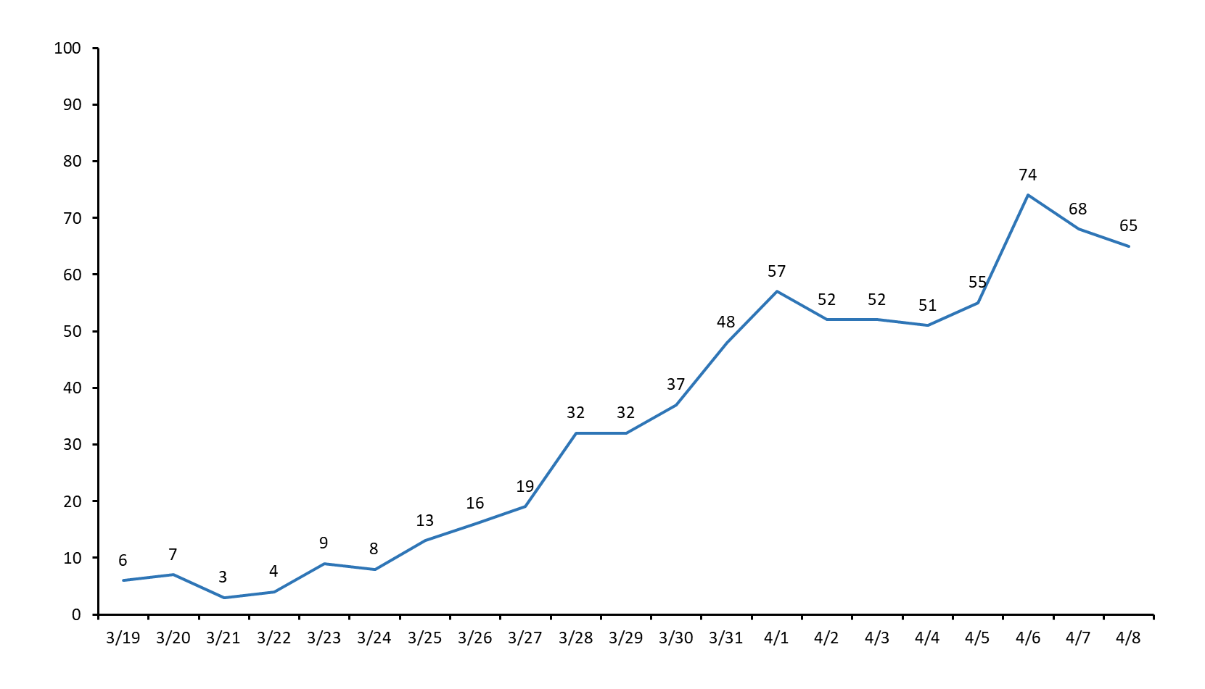
Daily COVID-19 Hospital Census in NH
Daily Hospitalized Cases
Date
Data provided by the NH Hospital Association

Slide 19
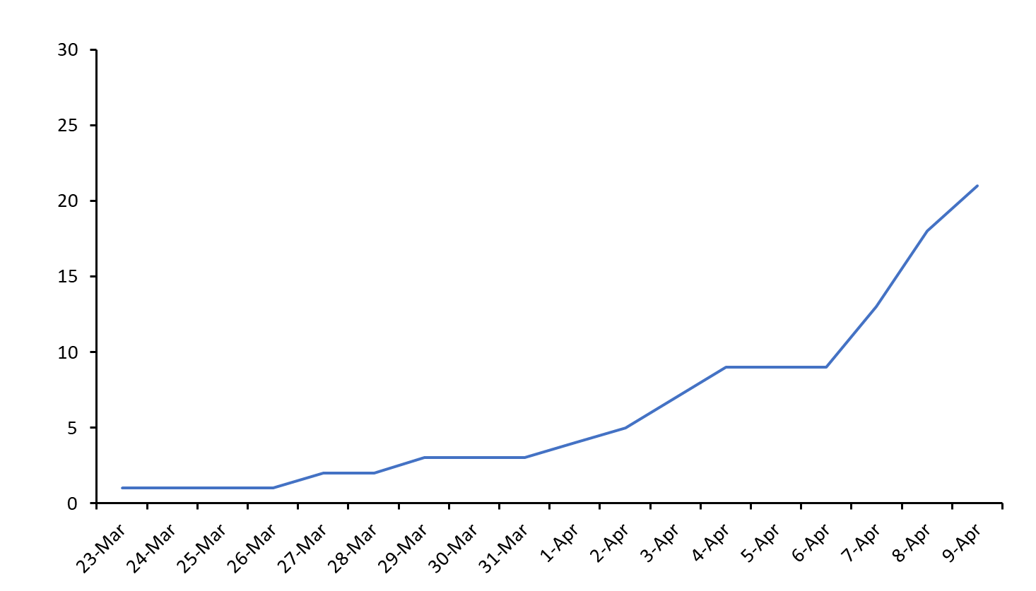
Total Number of COVID-19 Deaths in NH
Total Deaths
Date

Slide 20
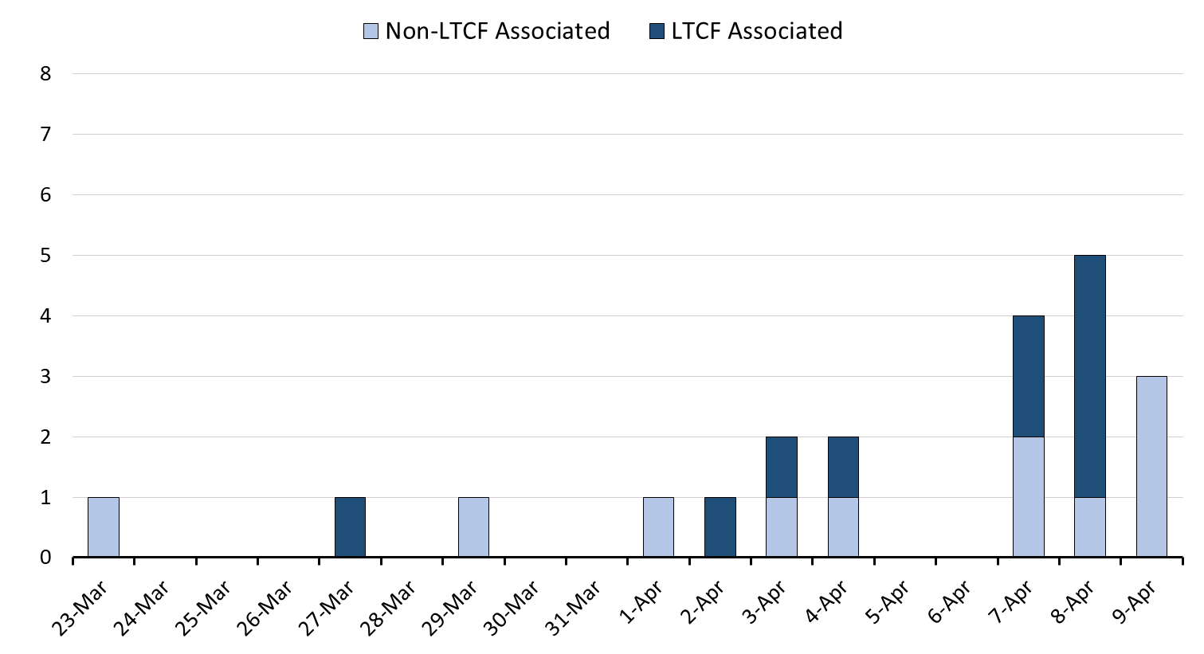
COVID-19 Deaths in NH Each Day
Number of Deaths
Date

Slide 21
Summary of Key Points
This epidemic will last many more weeks
Our NH strategy appears to be working
We need everybody to stay at home to protect people, especially older adults and those with chronic medical conditions
Models and our own NH data show that now is the critical time to continue our community mitigation strategy
Thank you for the work you are all doing to help stop the spread of this novel coronavirus

